Slide 1
In search of the fourth 90: Exploring and defining what quality of life means for communities and strategizing how we get there
Context and Introduction
Kevin Moody, BScPhm, MBA, EdD
AIDS 2018 25 July 2018

Slide 2
What is Quality of Life?
Different things for different people
Patient-centred
Chronic care principles

Slide 3
Diabetes
Manage Side Effects
Controlled Disease
Prevent co-morbidities
Faith
Safe
Happy
Start a Family
Financially Stable
Empowered

Slide 4
HIV
Manage Side Effects
Controlled Disease
Prevent co-morbidities
Faith
Safe
Happy
Start a Family
Financially Stable
Empowered

Slide 5
HIV
Manage Side Effects
Controlled Disease
Prevent co-morbidities
Faith
Safe
Happy
Start a Family
HIV Prevention
Financially Stable
Empowered

Slide 6
Positive Health Dignity and Prevention
https://www.gnpplus.net/assets/wbb_file_updown/2090/GNP_PHDP_ENG_V4ia_2.pdf

Slide 7
Quickfire survey results
Survey monkey was ‘up’ for 10 days – had 230 responses
Cleaned to remove duplicates and incomplete answers

Slide 8
Q1: Gender
Answered: 157 Skipped: 0

Slide 9
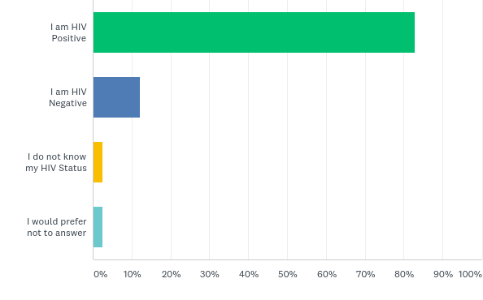
Q3: Your HIV status
Answered: 157 Skipped: 0

Slide 10
Countries of Residence, willingness to engage, attendance at AIDS 2018
Answered: 157 Skipped: 0
44 countries represented
For many only 1 or 2 respondents
Canada, India, Philippines, UK, USA all had more than 10 respondents
Of 157 respondents
124 wished to be contacted again
33 did not
60 respondents were attending AIDS2018
Six only attending the global village

Slide 11
Q6: Below is a list of 14 possible components of quality of life. We are asking you to make a top 7 out of the most important ones in your view and then rank them from 1 to 7 with “1” being the most important component and “7” being the least important . Please note: You will not be able to choose more than 7 or rank two components equally. You will need to pick at least seven
Answered: 157 Skipped: 0

Slide 12
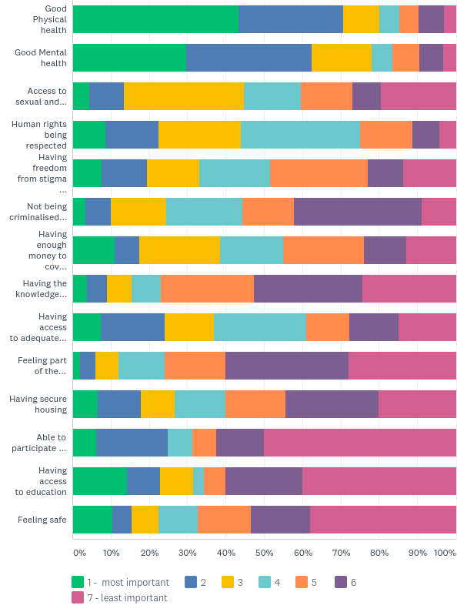

Slide 13
The 4th ‘90’ – Quality of Life
Beyond viral suppression – Lazarus et al.¹
HIV Outcomes: Beyond viral suppression²
https://bmcmedicine.biomedcentral.com/articles/10.1186/s12916-016-0640-4
http://hivoutcomes.eu

Slide 14
Barriers to implementation
Past experience with GIPA is mixed and often not meaningful
Systems in place are currently organized in silos
Approaches are system-, provider- or service-centred
Treating health is seen as treating a defect
Public health versus personalised care

Slide 15
Beyond?
For people whose virus is suppressed, it’s important to look at their health and wellness beyond undetectability
For others, quality of life measures need to be in place as a prerequisite to enter or stay in the continuum of care

Slide 16
Knowledge, Will and Power
Knowledge
Will
Power

Slide 17
Measurement
Are we talking about the same thing when referring to quality of life??
How do we know we’re doing the right things?
How do we know we’re doing them efficiently?
How can we show value for money and attract investment in community structures?

Slide 18
THANK YOU!
Kevin Moody
k@kevinmoody.org

